Slide 1

College of Technology (01)
Aditya Silver Oak Institute of Technology
Diploma Engineering Department of Information Technology(010)
Iot based smart Agriculture System
PROF.MAYANK PANCHAL
GOSKI JATIN KUMAR
SHIVAM GOR

Slide 2
Table of Content
1
Title Slide
2
Introduction
3
Problem Statement
4
Project Objectives
5
Components Used
6
System Architecture
7
Working Mechanism
8
IoT Platforms Overview
9
Hardware Setup
10
Software/Code
11
Data Analysis and Visualization
12
Advantages of the System
13
Limitations of the Current System
14
Enhancements for Future Scope
15
Cost Analysis

Slide 3
16
Real-World Applications
17
Social and Environmental Impact
18
Comparison with Traditional Farming
19
Security Considerations
20
Future Innovations
21
Conclusion
22
Thank You!

Slide 4
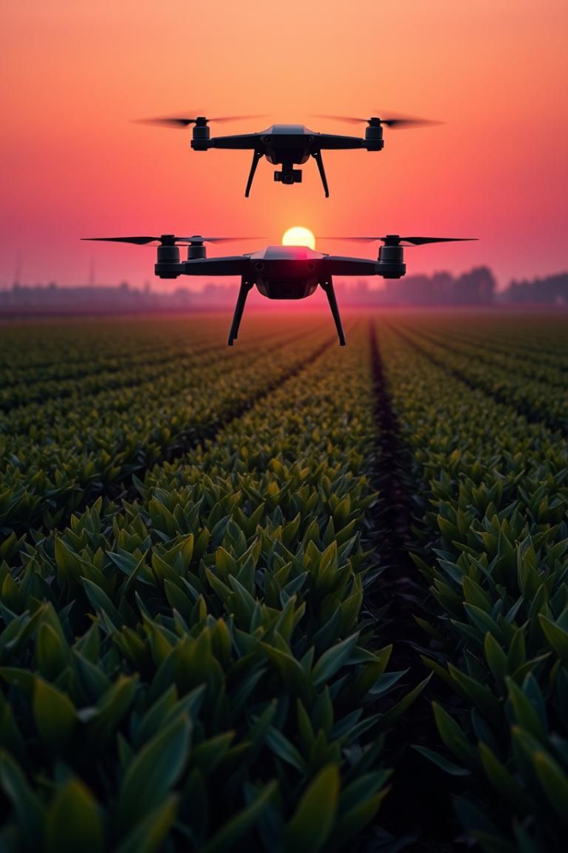
IoT-Based Smart Agriculture Monitoring System
A comprehensive look into smart agriculture using IoT for enhanced productivity, resource conservation, and data-driven insights.

Slide 5
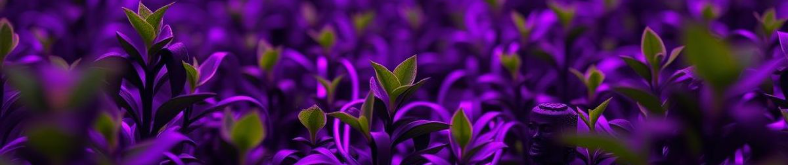
Introduction to Smart Agriculture
Tech Integration
Real-Time Monitoring
Enhanced Productivity
Improves agricultural efficiency
Provides automation and data decisions
Empowers farmers through tech

Slide 6
Addressing Traditional Farming Challenges
Weather Uncertainty
Resource Inefficiency
Labor Intensive
Unpredictable conditions affect yields
Over/under-irrigation occurs often
High costs due to manual labor

Slide 7
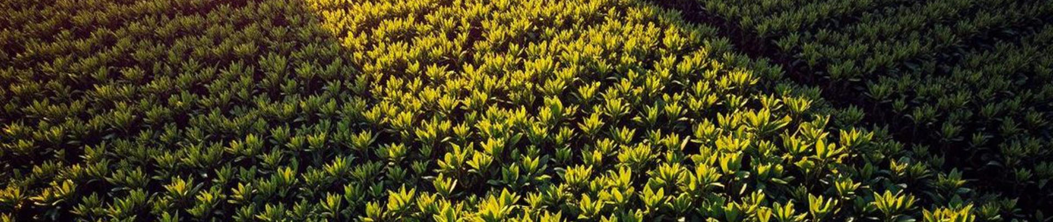




Project Objectives for Smart Agriculture
Automated Monitoring
Optimized Usage
Improved Yield
Remote Access

Slide 8

Key Components of the IoT System
Microcontroller
Sensor Suite
ESP8266/Arduino Uno
Soil moisture, water level, Smoke sensors and fire alarm sensor
Actuators
Connectivity
Water pump and motor
WiFi, cloud platforms

Slide 9








Smart Agriculture System Architecture
Data Acquisition
Data Transmission
Sensors gather real-time data.
Data transmitted through gateway.
User Interface
Cloud Platform
Access data, insights, and controls via mobile/PC.
Cloud stores and processes data.

Slide 10
Detailed Working Mechanism of the System
Sensor Monitoring
1
Measures environmental conditions
2
Data Processing
Microcontroller processes data
Cloud Upload
3
Data goes to the cloud
4
Automated Trigger
If low moisture notification triggered
Mobile Alerts
5
Farmers receive data/alerts

Slide 11



Software and Code Implementation
2
Libraries
1
Programming
Cloud Setup
3

Slide 12
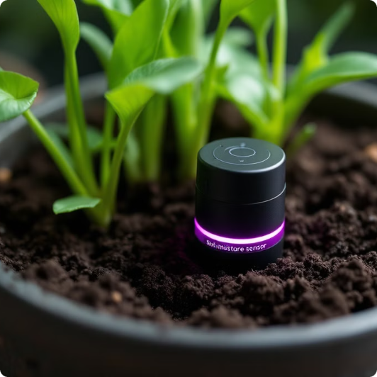
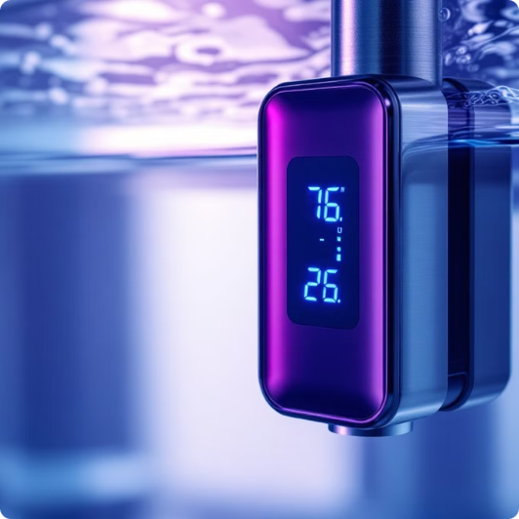
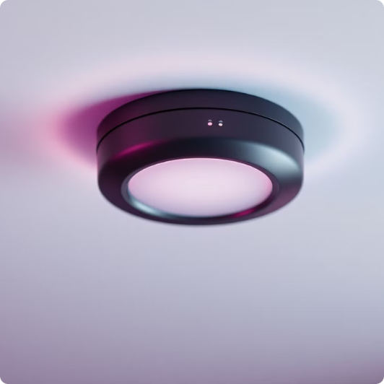
Gather Components
Soil Moisture Sensor
Water Level Sensor
Fire Sensor
Measures the volumetric water content in the soil.
Detects the water level in the tank.
Detects the presence of fire or smoke.

Slide 13
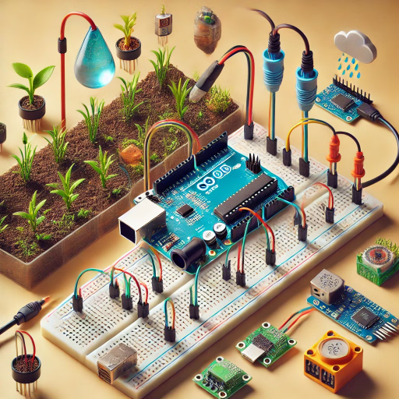
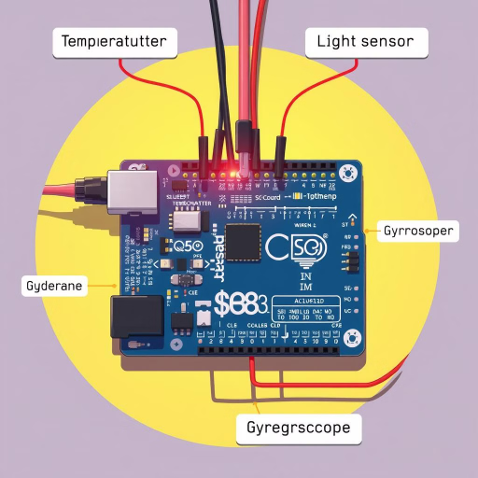
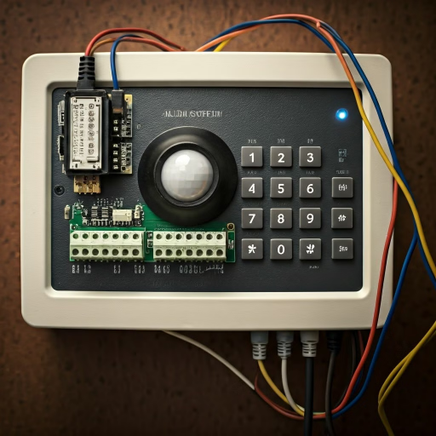
Practical Hardware Setup and Wiring
Wiring Diagram
Sensor Integration
Actuator Setup
Arduino/ESP8266 setup
Connect sensors to the board
Integrate the Alarm system

Slide 14
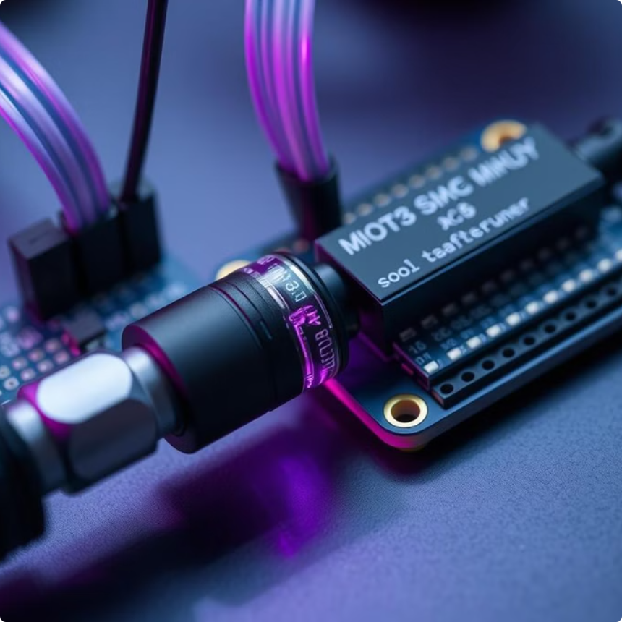
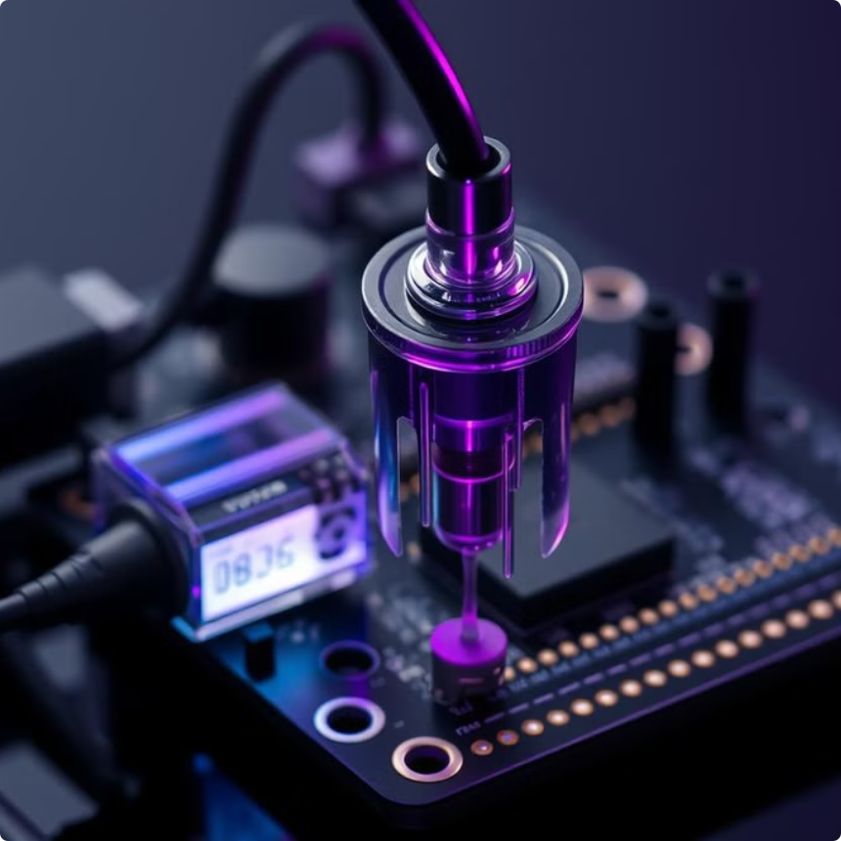
Assemble the Hardware
Connect Soil Sensor
Connect Water Level Sensor
Connect the soil moisture sensor to an analog pin on the microcontroller.
Wire the water level sensor to monitor tank levels, ensuring proper water supply.

Slide 15
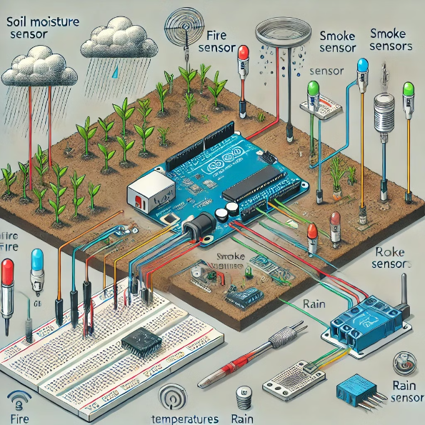
Assemble the Hardware
1️⃣ Soil Moisture Sensor
Placed in the soil to measure moisture levels.
Wired to the microcontroller, which processes data to decide when to activate irrigation.
2️⃣ Fire Sensor
Mounted near crops to detect excessive heat or fire risks.
Triggers an alert system (e.g., buzzer or notification).
3️⃣ Smoke Sensor
Positioned to monitor hazardous fumes or smoke from fires.
Connected to an alarm or automated response system.
4️⃣ Rain Sensor
Installed above ground to detect rainfall.
Can trigger actions like stopping irrigation during rain.
5️⃣ Warning Sensor (LED + Buzzer System)
Alerts farmers visually and audibly about critical conditions.
Signals issues detected by any of the sensors.

Slide 16



Software Code Upload Timeline
Open IDE
Open Arduino IDE.
Install Libraries
Install DHT, ESP8266WiFi, ThingSpeak or Blynk.
Upload Code
Read sensors, send to cloud, control alarm

Slide 17
Set Up Cloud Platform
Create Account
New Channel
Link Device
Sign up on the chosen IoT platform.
Configure a new channel for your IoT project. Define the data fields from sensors.
Use the API keys to link your microcontroller. Push sensor readings to the cloud channel.
Setting up a cloud platform enables remote monitoring and data analysis. Properly configure the cloud platform to work with the system.

Slide 18
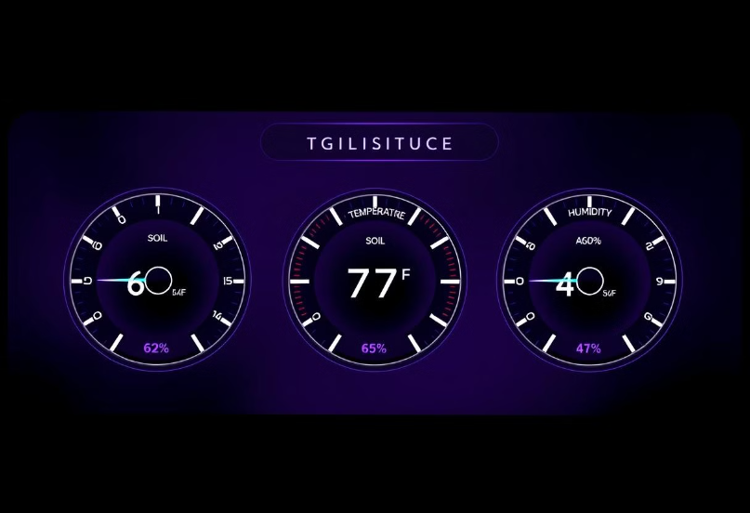
Test the System
Check Sensor Readings
Check the live sensor data, including temperature, humidity, and soil moisture.
Trigger Automation
Simulate dry soil conditions. The water sensor alarm should activate automatically.
Mobile/PC Monitoring
See real-time data visualization. Use the ThingSpeak or Blynk dashboard.

Slide 19
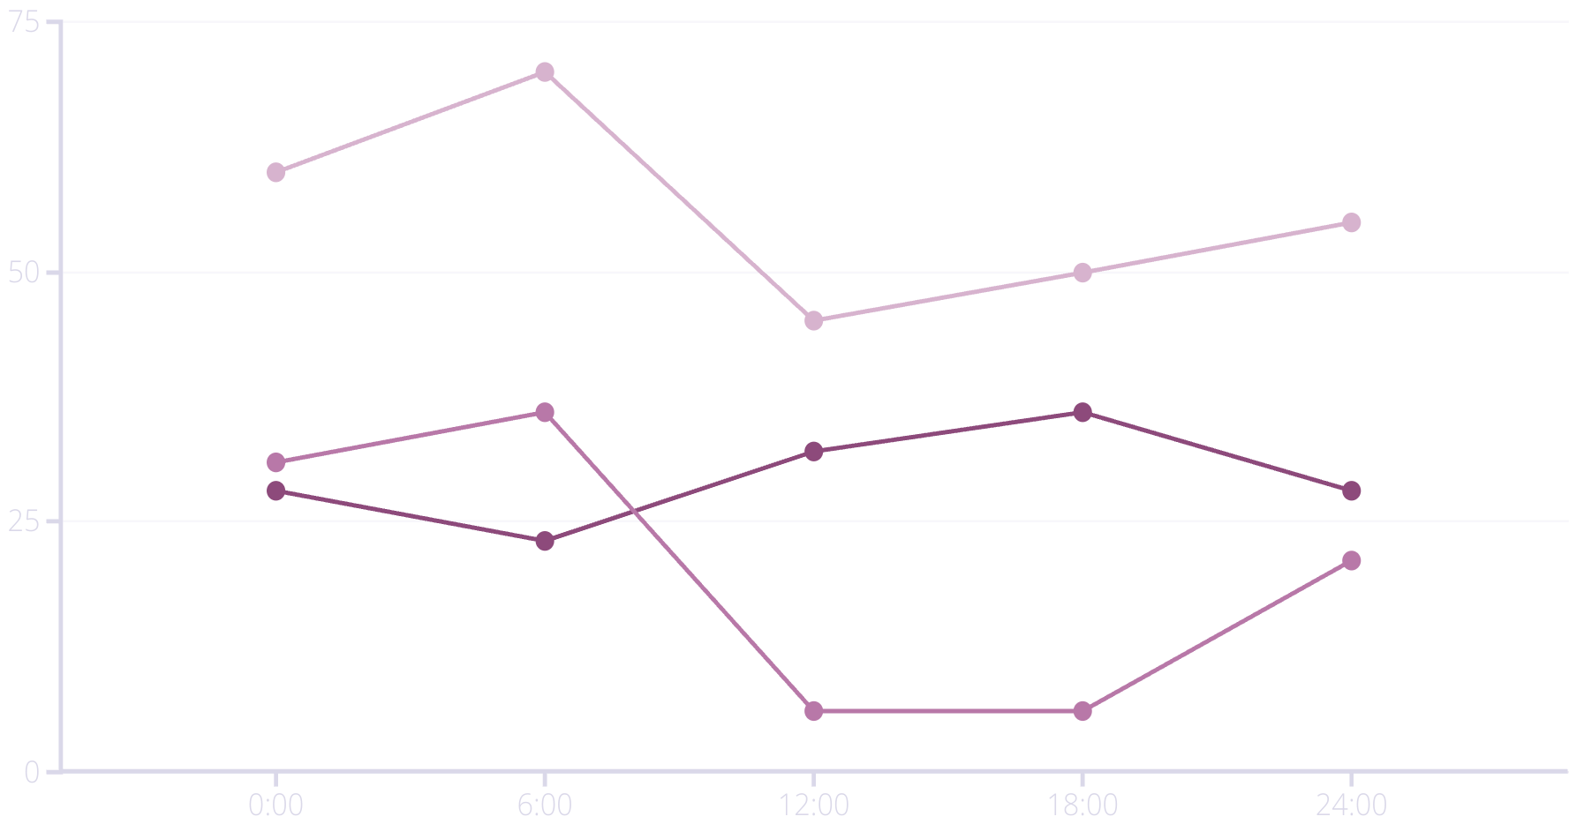
Data Analysis and Visualization
Analyzing sensor data is critical for smart agriculture. Understand data variations.
Temperature (°C)
Humidity (%)
Soil Moisture (%)
The line chart shows sensor data trends for temperature, humidity, and soil moisture. Time is on the X axis, sensor data on the Y axis.

Slide 20
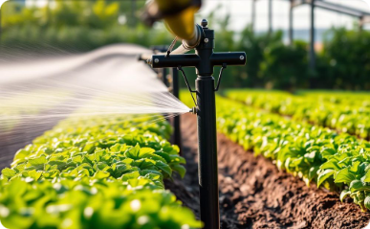
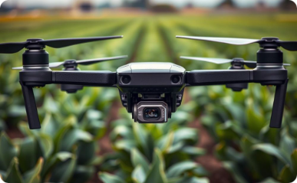
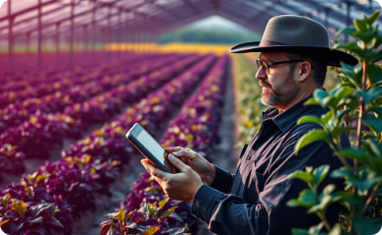
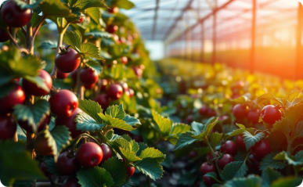
Advantages of Smart Agriculture System
Improved Efficiency
Reduced Labor
Remote Monitoring
Higher Yield
Smart systems reduce water and energy usage.
Automation decreases human intervention for monitoring.
Control the agricultural process from anywhere.
Optimized plant care leads to increased yields.

Slide 21



Limitations of the Current System
Sensor Calibration
Accuracy degrades over time.
Regular maintenance is needed for sensors.
Connectivity Issues
Rural areas often lack reliable WiFi.
System performance decreases in remote areas.
Power Dependency
Battery and solar efficiency varies.
Consistent power is crucial for operations.

Slide 22




Cost Analysis
Microcontroller
₹300-900 each
Sensors
₹5000-30000 each
Actuators
₹500-700
Power Supply
Based on your Electricity supply
Total Cost
5
An affordable DIY setup for ₹1.5L-2L

Slide 23
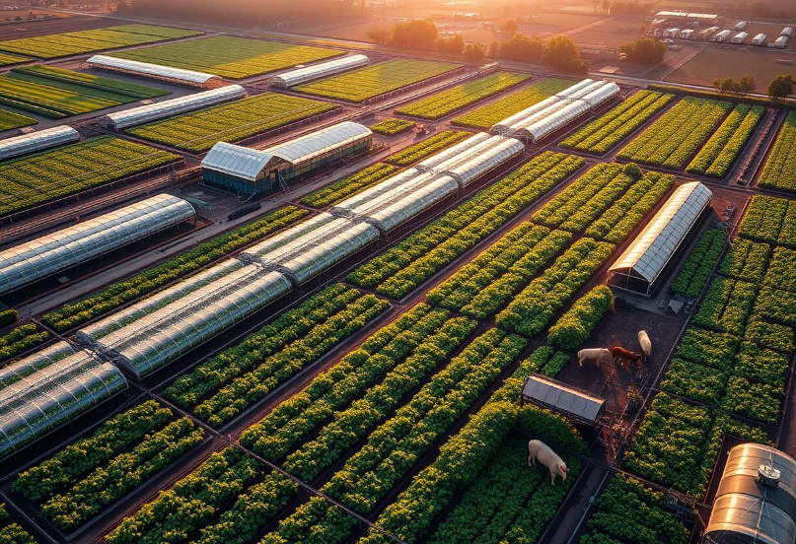
Real-World Applications
Greenhouse monitoring: Regulate temperature, humidity, and light. Maintain optimal growing conditions.
Precision irrigation systems: Deliver water precisely. Reduce waste. Optimize plant health.
Livestock environment control: Monitor animal comfort. Ensure optimal feeding. Automate climate control.
Smart gardens: Automate watering schedules. Monitor soil conditions. Improve yield.

Slide 24



Social and Environmental Impact
Water Conservation
Food Security
Sustainability
Smart agriculture uses controlled irrigation. This minimizes water waste.
Increased crop yield and reduced loss improves food supply.
Eco-friendly energy reduces environmental impact.

Slide 25
Comparison with Traditional Farming
Resource Efficiency
Labor Needs
Traditional farming often wastes water. IoT-based optimizes usage, conserving water and energy.
Traditional methods need many manual workers. IoT tech reduces labor through automation.
Crop Yield
Data Accessibility
Yields are inconsistent with manual methods. IoT systems lead to higher, more predictable yields.
Traditional farming lacks real-time data. IoT provides continuous data for informed decisions.

Slide 26
Security Considerations
1
Data Privacy
2
Device Vulnerabilities
3
Network Security
Farms produce sensitive data. Securing transmission is critical. Use encrypted communication.
IoT devices are susceptible to exploits. Regular firmware updates are essential for protection.
Protect the network from unauthorized access. Employ firewalls and intrusion detection systems.

Slide 27
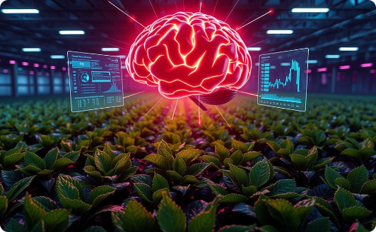
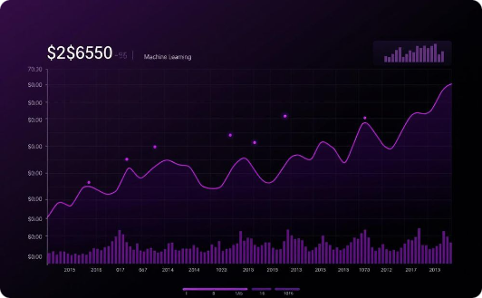
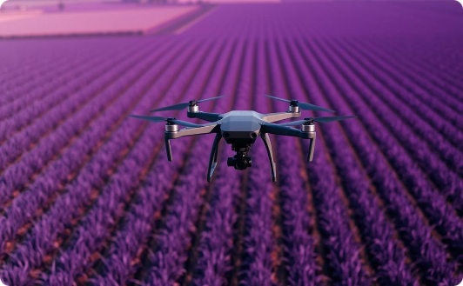
Enhancements for Future Scope
AI Integration
Machine Learning
Drone Monitoring
AI can predict crop diseases. It can also automate fertilization based on real-time analysis.
Machine learning analyzes data. This can improve irrigation and planting schedules based on history.
Drones provide aerial imagery. They can monitor crop health. They can also identify pests.

Slide 28


Future Innovations
Blockchain Integration
Robotics
Nutrient Monitoring
Blockchain ensures data transparency. It can be used in farming processes.
Autonomous machines perform plowing and harvesting. They can also do sowing.
Real-time soil analysis helps with fertilization. This provides very precise control.

Slide 29



Conclusion
Efficiency
IoT boosts resource use, enhancing farm yields.
Insights
Real-time data aids better, faster farming choices.
Future
AI-driven farms create self-sustaining systems.
IoT transforms farming, making it smarter and greener. Automation optimizes farming for the future.

Slide 30
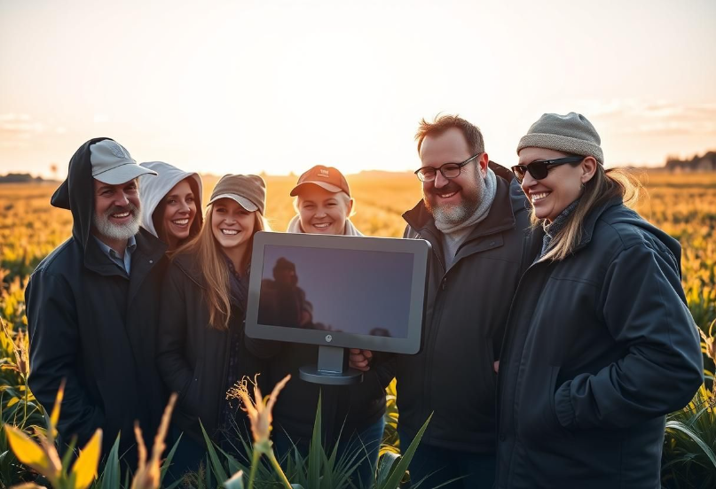
Thank You!
Q&A Session
Empowering farmers is the key goal. We want to promote a sustainable future.
“Empowering Farmers with Technology for a Sustainable Future!”

